Slide 1
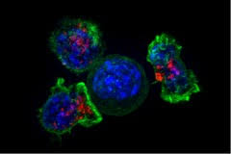
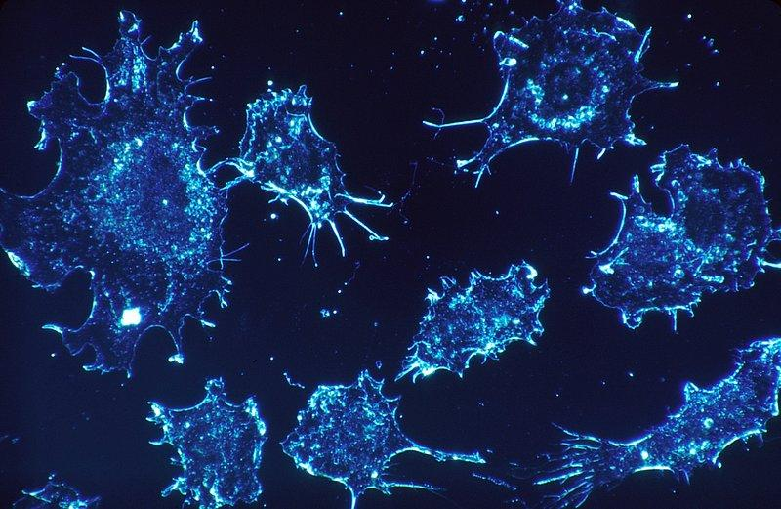
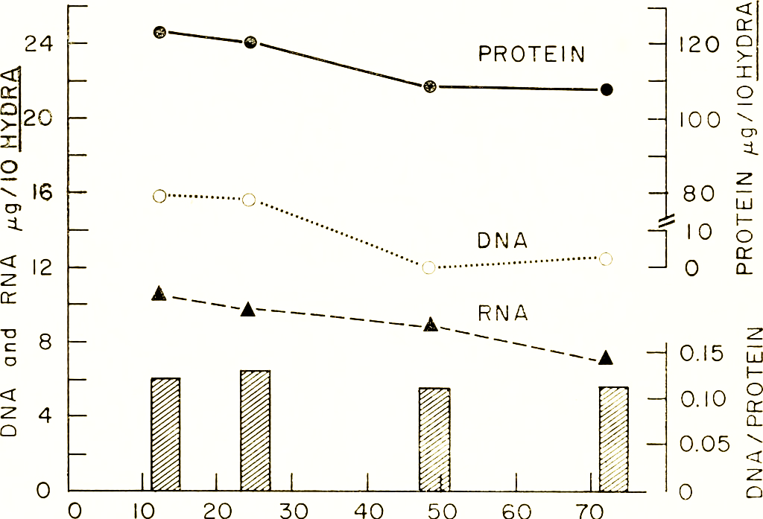
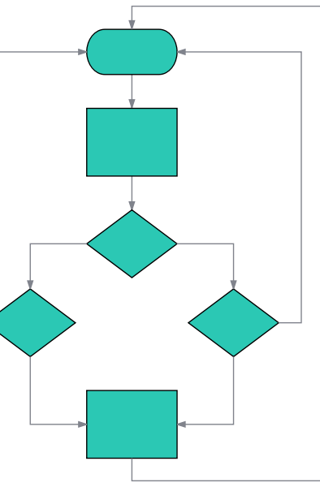
Scientific Poster Title
(use this font size)
Insert another logo of Program or Institution
Add author names and affiliations as approved with submitted abstract
Ex. First Name and Last Name, Department of Biological Sciences, Hunter College
Background
Data/Results
Conclusions
Brief (bullet points, if possible) description of the research area, significance, questions remaining unanswered.
Add your information, graphs and images to this section. USE LOTS of images, where possible. Provide Number and Legends to all figures.
A summary of what the chart/figure/table shows can be provided as a “title” above the chart/figure/table or as the “title” in the legend. (EXAMPLE: “Lipopolysaccharide (LPS) and Interleukin 4 (IL4) induce B lymphocytes to switch to production of IgG1 or IgE” – above a plot that shows the effect of LPS + IL4 on secreted Ig from splenic B cells)
Bullet list of what your data shows and how you interpreted the results.
Include the “take home” message from your data.
Objective/Hypothesis
Future Directions
Summarize what you were asking, why it is important, and your hypothesis regarding the answer to that question(s).
Figure 1. Immunoflourescence of fibroblasts using xyz staining. 100X magnification.
Figure 2. Activated lymphocytes using xyz staining. 100X magnification.
Bullet list of where the work needs to proceed from this point forward.
Methods
References (if any)
If you have one methodology that covers all your work, you can explain it here. Or, show flow chart summary. Consider using tools like Biorender to help visualize.
If your project uses many different methods, you may describe them in pictures along with your results.
If the data you are showing has been published, you’d put the reference here. If you cite earlier studies in your poster, add a superscript with a number and add the reference here.
Acknowledgements
Usually used for adding funding acknowledgements for PI’s lab (e.g. NIH grant #...), special programs: REU/SURP, MARC, BPENDURE, McNulty, Yalow Honors Scholar Program, etc
Figure 3. Relative content of whole blood samples in micrgrams at 10 minute intervals.

